Slide 1
Classification of App Reviews for the messaging app „Signal“
Using Huggingface‘s „zero-shot-classification“ Transformer

Slide 2
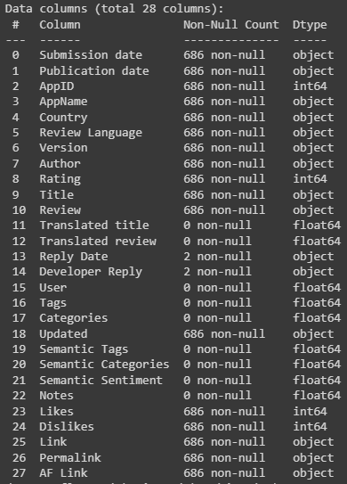
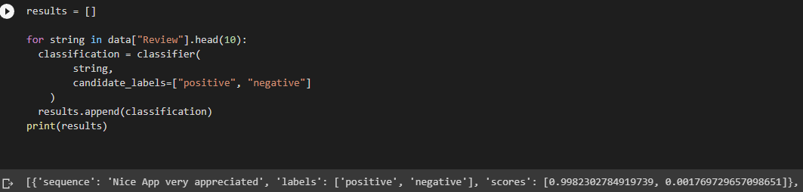
Data was extracted from an XML file, provided by the IOS App Store
Identify whether a review is intended to sound positive or negative.

Slide 3
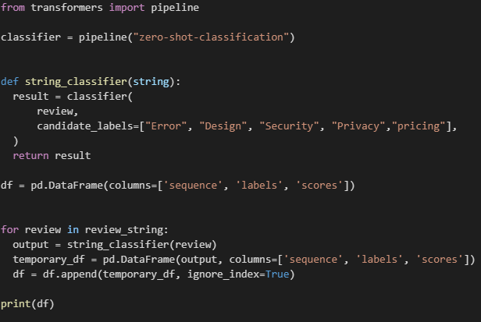
Use HuggingFace‘s zero-shot-classification Transformer
Parse Reviews from XML File as a String to Transformer
Set labels¹
Error
Design
Security
Privacy
Pricing
¹ no theoretical reasoning for choosing this subset of labels

Slide 4

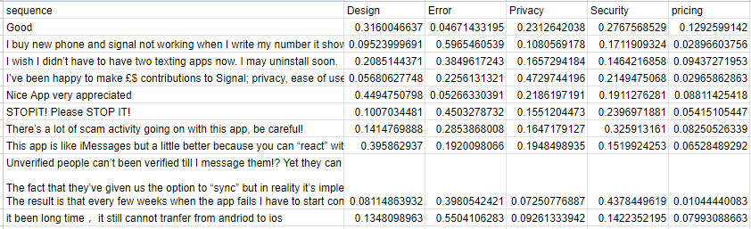
Transform table to pivot and export it as CSV
Output csv file
Because of computing capacity, only performed on 10 reviews

